Slide 1
Accelerating Trasformers via Multi-tiered Memory
Kexin Chu, Ricky Cheng, Dawei Xiang, Shouwang Zhu
University of Connecticut
Notes:
Today，I have the pleasure of presenting to you an innovative approach to enhancing the efficiency of Large Language Model Inference.
This Work is ’CaR: An Efficient KV Cache Reuse System’.

Slide 2
CONTENTS
Intruduction to LLMs and KV cache
Motivation and Challenges
Design Details
TestBed and Implementation
Our Experiment and Conclusion
Notes:
My presentation will be divided into 4 parts.
Firstly, I will start with the Introduction to Large Language Models, and delve into the definition and importance of the KV cache in self-attention. This foundational knowledge will be crucial to my motivation and design.
Secondly, we will explore the motivation and challenges that led to the development of CaR. Here I will explain what problem CaR is trying to solve and what new challenges are faced in solving this problem?
In the third part, we will deep-dive into the design details of our CaR system，showcasing the overall architecture and details of each module. I will explain hot CaR addresses the above challenges.
Finally, I will then present our preliminary experiments and the conclusions drawn from them. Highlighting the effectiveness and impack of the CaR system.

Slide 3
01
Intruduction to LLMs and KV cache

Slide 4
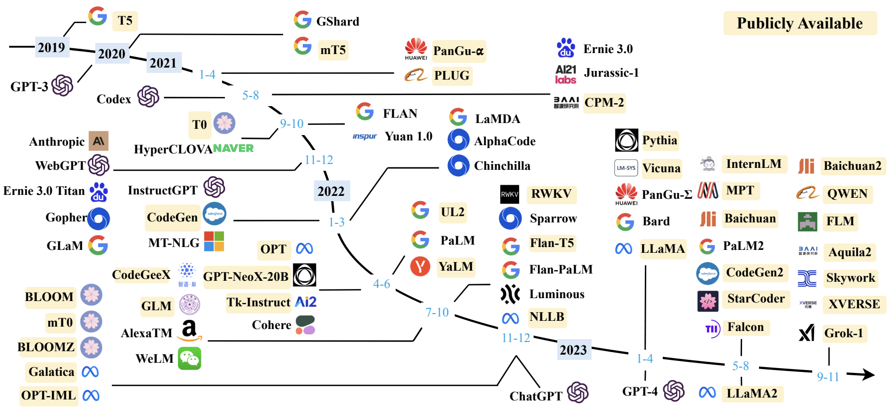
The era of LLMs
More companies are launching LLM models, expanding the AI landscape. [1]
[1] A Survey of Large Language Models (https://arxiv.org/pdf/2303.18223)
Notes:
Firstly, I will give a brief introduction of the development of Large Language Models.
Since the remarkable GPT-3 and ChatGPT was launched by OpenAI，GPT have redefined the potential of AI, capturing the attention of the tech world and beyond.
The evolution of LLMs has been nothing short of exponential. We've moved from an era where model iterations were measured in years to one where new, more powerful models emerge almost monthly. This acceleration underscores the dynamic and competitive nature of the field, with each new model promising to push the boundaries of what's possible.

Slide 5
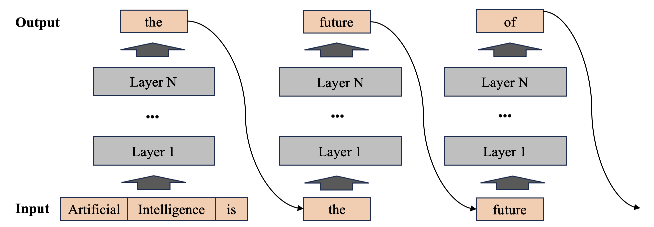
LLM Inference Process
Two stages:
Prefill: first iteration, compute all input tokens in a single pass
Decode: utilize previous generated token as input
Regressive generation
Layer by layer
Notes:
Following our overview of the rapid evolution in the LLM landscape, we now turn our attention to the core of our discussion: the Large Model Inference process. This process is typically bifurcated into two distinct phases: prefill and decode.
During the prefill stage, the system ingests the user's input, which includes the prompt and question. In a single iterative cycle, it computes all tokens and generates a single token as the output. As depicted in the illustration, the first iteration represents the prefill phase. The model takes 'artificial intelligence is' as input, processes it through all the layers, and outputs a single word: 'the'.
Transitioning into the decode phase from the second iteration onwards, the model feeds the output of the previous iteration as input, calculating and producing the next token. This cycle continues, with 'the' leading to 'future', and so on, as the model iteratively generates subsequent tokens. This process persists until the model produces an end-of-sequence token, EOS, or reaches the maximum length limit set by the model.

Slide 6
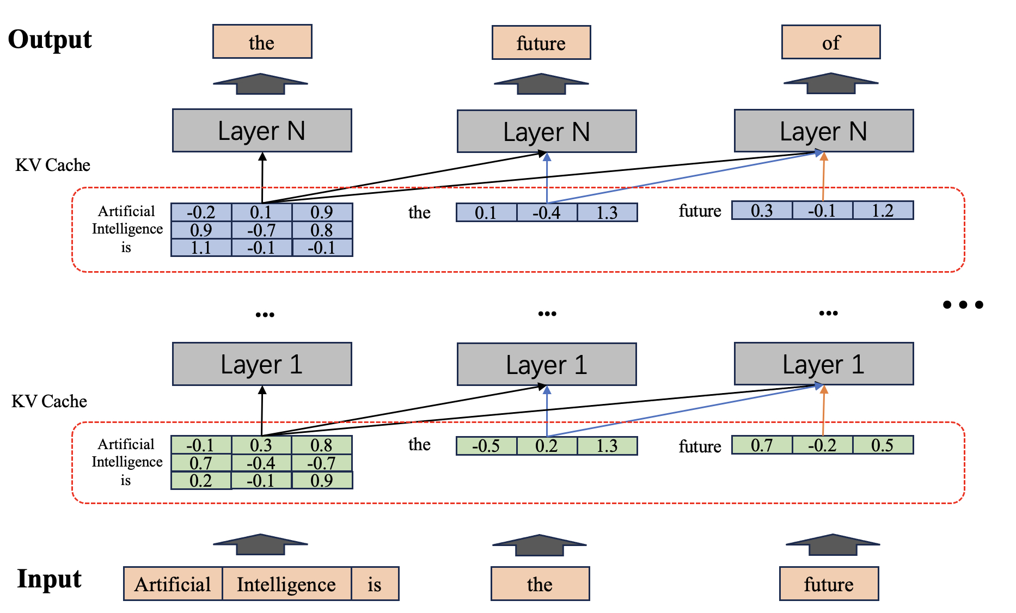
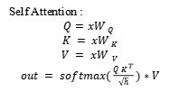
Self-Attention & KV cache
Self Attention :
$$Q=xW_{ Q}$$
$$K = xW_{ K}$$
$$V = xW_{ V}$$
$out = softmax(\frac{Q K^{ T}}{\sqrt{h}})∗V$
Notes:
Moving deeper into the intricacies of Large Language Models, we now explore the computational engine at the heart of every layer: the self-attention mechanism. Each layer in an LLM comprises a self-attention module coupled with a feed forward network, the latter being a Multilayer Perceptron.
On the left, we illustrate the core function of self-attention. Given an input 𝑥, it's transformed through weight matrices 𝑊_𝑄, W_K, and W_V to produce the query 𝑄, key 𝐾, and value 𝑉 vectors, respectively. These vectors are then used to calculate the attention score matrix, which encapsulates the relationships between the input 𝑥 and all preceding tokens, as depicted in the diagram on the right.
It's important to note that the key 𝐾 includes not only the current input's key vector but also those from historical inputs. This inclusion is what allows the model to maintain context and generate coherent, contextually aware responses.
Continuing our exploration of the self-attention process, after deriving the attention score matrix, the next step is to apply the softmax function. This transformation normalizes the attention scores, allowing us to interpret them as probabilities. The softmax function plays a crucial role in focusing the model's attention on the most relevant parts of the input sequence.
With the probabilities now in hand, we multiply them by the value vectors 𝑉, which, like the keys 𝐾, include not only the current input's value vector but also those from historical tokens. This multiplication effectively computes a weighted sum of the value vectors according to the attention scores, giving rise to a new token.
These key 𝐾 and value 𝑉 vectors, which are reused in subsequent decode stages, form the backbone of what we refer to as the KV cache.
The KV cache is thus a repository of contextual information that the model reutilizes to maintain consistency and coherence throughout the generation process. It's this reuse of the KV cache that becomes the cornerstone of efficiency in Large Language Model inference.

Slide 7
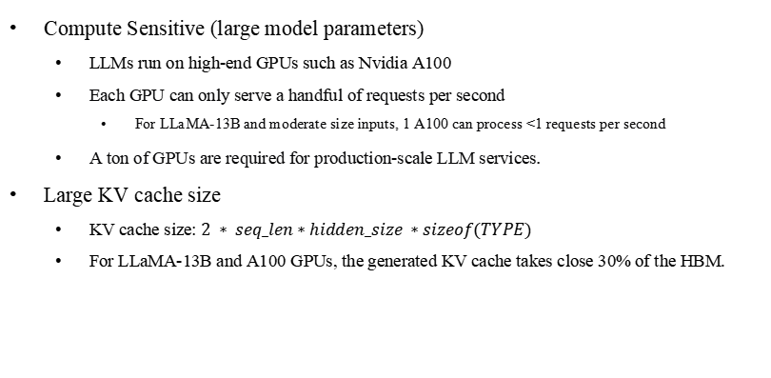
Serving LLMs is Expensive
Compute Sensitive (large model parameters)
LLMs run on high-end GPUs such as Nvidia A100
Each GPU can only serve a handful of requests per second
For LLaMA-13B and moderate size inputs, 1 A100 can process <1 requests per second
A ton of GPUs are required for production-scale LLM services.
Large KV cache size
KV cache size: $2 ∗ seq_len∗hidden_size ∗sizeof(TYPE)$
For LLaMA-13B and A100 GPUs, the generated KV cache takes close 30% of the HBM.
Notes:
Building on our previous analysis, we now turn our attention to the high costs associated with Large Language Model inference. Inference with LLMs is inherently computationally intensive, necessitating the use of powerful GPU devices such as the Nvidia A100 to handle the complex computations.
However, even with such advanced hardware, the throughput of LLM inference remains limited. For instance, a single A100 GPU with the LLaMA-13B model can process barely one request per second. This limitation underscores the need for a substantial investment in GPU resources to provide LLM inference services at scale.
Furthermore, the KV cache generated during the inference process presents another significant challenge. The size of the KV cache grows linearly with the length of the input sequence. However, the memory available on GPUs is not only limited but also comes at a high cost. This trade-off between memory capacity and computational demand places additional constraints on the scalability and efficiency of LLM inference.

Slide 8
02
Motivation and Challenges

Slide 9
Opportunity for KV cache reuse
The related KV cache is directly discarded once the request is completed.
Scenarios with similar prefix tokens
Few-shot aibot
Multi-turn chat
Tree of thoughts
Notes:
Leveraging the insights from our previous discussions, we now delve into the computational intensity of the prefill phase. It's in this stage that we identify an opportunity for optimization, especially in scenarios where user requests exhibit similar prefix tokens.
Consider the few-shot AI bot scenario, where an LLM-based application for translating English to French might utilize one or more examples as prompts. These prompts serve as the prefix tokens for the requests and remain largely unchanged across multiple uses. Similarly, in the more common multi-turn chat scenario, the user's input history and the model's responses also act as prefix tokens to provide the LLM with better contextual coherence.
However, in current LLM systems, these similar prefix tokens are often recalculated, as there is no consideration given to the inter-request relationships. Each request is treated as an isolated instance, leading to inefficiencies in the prefill process.
By recognizing the presence of similar prefix tokens across requests, we uncover a significant area where computational resources can be conserved. The CaR system is designed to capitalize on this pattern, reducing redundancy and enhancing the overall efficiency of LLM inference.

Slide 10
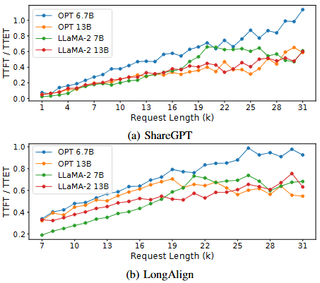
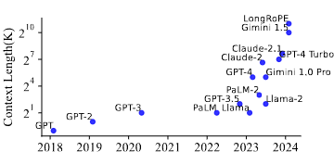
Prefill Re-compute Costs
The computational overhead during the prefill stage increases with the length of the prompt.
LLM models are developed to support longer contexts.
Notes:
Following our exploration of scenarios conducive to KV cache reuse, this slide presents experimental evidence that reinforces the importance of addressing prefill latency in LLM inference. We've conducted a study to measure the latency of the prefill phase, known as Time to First Token (TTFT), in relation to the end-to-end inference time, Time to End Token (TTET), across varying lengths of prompts.
The results clearly demonstrate that as the length of the request prompt increases, the proportion of TTFT in the overall TTET also increases. This trend underscores the growing significance of prefill latency as the prompt length expands.
Moreover, as depicted in the accompanying chart, the ability to support longer context lengths has been a recent trend in model development. When we combine these insights, it becomes evident that the issue of KV cache reuse is not just theoretical but a tangible challenge that, when addressed, can significantly enhance the efficiency of LLM inference.

Slide 11
Motivation
The expensive computation in the prefill stage can be avoided by reusing the KV cache from the previous requests.
The large KV cache storage has become a bottleneck in LLM inference.
Multi-tier Memory System
Active blocks are stored in HBM of GPUs.
Inactive blocks are stored in external Mem.
SMs
Model parameters
Large capacity external storage
Others
KV cache
GPUs
… …
Notes:
But the large KV cache storage has already become a bottleneck in LLM inference because the memory on GPU is expensive and limited.
So storing historical KV cache information directly in GPU memory is impractical due to the substantial memory footprint it would require, potentially hindering the GPU's ability to respond to other requests.
To overcome this limitation, we introduce an external storage solution. By leveraging CXL-based DRAM as external memory, we can persist large volumes of KV cache data outside the confines of the GPU. This approach not only conserves valuable GPU memory but also supports efficient data interchange between the GPU and DRAM.

Slide 12
Challenges in Multi-tier KV Cache System
Where to place the KV cache of previous requests?
The HBM on GPUs is small and fast.
The DRAM-based external memory is large but slow.
How to limited the data transfer overhead?
Maximize the use of KV cache in HBM of GPUs
Avoid frequent data transmission between GPUs and DRAM
When to migrate the data across the tiers?
Avoiding the GPU stall waiting for the data to be loaded from DRAM-based memory.
Avoid prefetch too early.
Notes:
As we transition to a multi-tier memory structure for our KV cache system design, we encounter a new set of challenges that are central to the CaR system's innovation. Let's break down these challenges one by one.
Firstly, we have the issue of data placement. GPU memory is fast but limited in capacity, making it ideal for storing KV cache data that needs rapid access. However, its constraints push us to offload some data to external storage. Deciding which KV cache to offload is our first challenge.
Secondly, the inevitability of data interaction brings us to the second challenge: reducing the overall data interaction overhead. This is especially critical to avoid letting these interactions fall on the critical path of LLM inference, where they could significantly impair performance.
Thirdly, to prevent data transfer costs from landing on the critical path, we must determine when to initiate data transfers in advance. Timing these operations correctly is essential to ensure smooth and efficient LLM inference processes.
These three challenges are not just hurdles but also focal points for the CaR system's design. Addressing them is key to enhancing the efficiency and performance of KV cache management in LLM inference.

Slide 13
03
Design Details

Slide 14
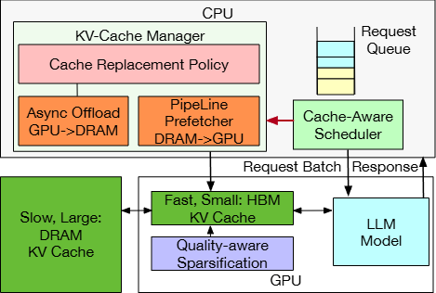
Overview
Co-design of Scheduler and Cache Management.
Replacement Policy
Cache -Aware Scheduler
Prefetch Predictor
Quality-aware Compression algorithm.
Pipeline data loading and asynchronous offloading
Notes:
Let's now delve into the architecture of our CaR system, a solution to the challenges we've just discussed. The CaR system is composed of three primary modules:
1, the Co-design of Scheduler and Cache Management. This module is further divided into three sub-modules:
A, The Replacement Policy, which is tasked with deciding which data to offload to the next storage tier when the memory space is insufficient. It's a critical component that ensures we make the most of our limited GPU memory.
B, The Cache-Aware Scheduler, which determines which request from the current queue should be processed next to maximize the utilization of the KV cache in GPU memory. This scheduler is intelligent and strategic, optimizing the GPU's resource allocation.
C, The Prefetch Predictor, addressing our third challenge by predicting the optimal time to initiate data prefetch operations. It's a forward-looking component that streamlines our system's efficiency.
2, we introduce the Quality-Aware Compression Algorithm. This innovative algorithm compresses the size of the KV cache, further reducing data interaction overhead.
3, we have the Pipeline data loading and asynchronous offloading module, which used to do the data transmission between GPU and CXL-based memory

Slide 15
Co-design of Scheduler and Cache Management
Maximizing KV cache reuse requires avoiding task waiting caused by frequent data offloads and prefetches.
Scheduler
Use shuffle windows to categorize requests into three groups.
A fixed size window is used to prevent frequent changes in the order of requests.
Standard：
The size of KV cache to be transmitted from DRAM to GPUs
Highest: the needed KV cache already in the HBM.
Second: do not involve any historical KV caches.
Lowest: The size of KV cache to be prefetched
Notes:
Firstly, we turn our focus to a vital component of the CaR system: the Scheduler. The Scheduler's role is to select a request from the request queue and prepare it for computation on the GPU. Its primary goal is to maximize the reuse of the KV cache in GPU memory.
To achieve this, the Scheduler prioritizes requests based on the size of the KV caches that need to be prefetched. This strategy aims to minimize data interaction overhead, which is crucial for maintaining system efficiency.
Let's break down the priority levels:
Highest Priority is given to requests where all required KV cache is already resident in the GPU memory. These requests can proceed without any additional data loading, making them the most efficient to process.
Second Priority is assigned to requests that do not share any prefix tokens. Since there's no need to load a KV cache for these requests, they can be processed quickly, contributing to the system's throughput.
To avoid the computational overhead of frequent sorting of the request queue, we introduce Shuffled Windows. These windows limit the frequency of sorting operations, thereby reducing the additional computational cost associated with queue management.
The Scheduler is not just a dispatcher; it's an optimizer that intelligently manages the request queue to enhance the GPU's utilization of the KV cache, ensuring that data interactions are kept to a minimum while maintaining the system's responsiveness.

Slide 16
Co-design of Scheduler and Cache Management
Replacement Policy
Determine which block of KV cache need to be offload when HBM is full.
Avoid the deletion of the KV cache that is relied by active requests.
Use Score to target the KV cache blocks.
Standard: evict the memory block with the smallest score
When a request enter to shuffled windows, the score of related blocks adds 1
When a request enter to GPU for inference, the score of related blocks adds 1
When a request complete it’s inference, the score of related blocks subs 2
Notes:
Here, I want to iintroduce the Replacement Policy. It is used to determine which block of KV cache needs to be offloaded when our High Bandwidth Memory (HBM) reaches its capacity.
Our primary objective is to avoid the deletion of KV cache blocks that are still relied upon by active requests. This is crucial to prevent disrupting the ongoing inference processes and to ensure a smooth operation.
At the heart of our Replacement Policy is the 'Score' system. This scoring mechanism targets the KV cache blocks that are candidates for eviction. The standard we follow is straightforward: we evict the memory block with the smallest score.
The scoring system is dynamic and responds to the state of our system in real-time:
When a request enters the shuffled window, the score of the related KV cache blocks increases by 1. This reflects the potential need for these blocks in the near future.
As a request moves into the GPU for inference, the score of the related blocks increases by another 1, indicating their active reliance by the current computation.
Upon the completion of a request's inference, the score of the related KV cache blocks decreases by 2. This reduction signifies that these blocks are now less critical.
This scoring algorithm ensures that our cache management is both proactive and responsive, making intelligent decisions about which data to retain and which to offload, based on the real-time demands of our system.

Slide 17
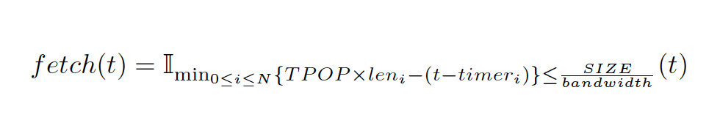
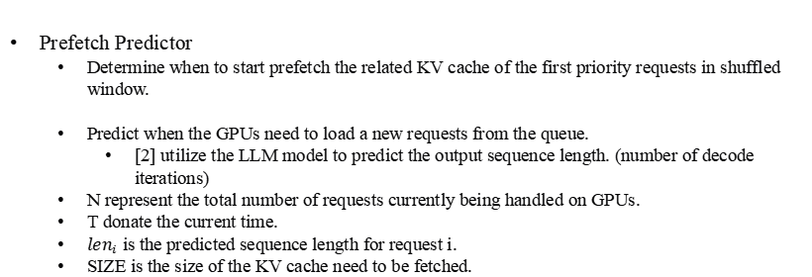
Co-design of Scheduler and Cache Management
Prefetch Predictor
Determine when to start prefetch the related KV cache of the first priority requests in shuffled window.
Predict when the GPUs need to load a new requests from the queue.
[2] utilize the LLM model to predict the output sequence length. (number of decode iterations)
N represent the total number of requests currently being handled on GPUs.
T donate the current time.
${len}_{i}$ is the predicted sequence length for request i.
SIZE is the size of the KV cache need to be fetched.
[2] Response length perception and sequence scheduling (https://arxiv.org/pdf/2305.13144)
Notes:
The prefetch predictor, determining the optimal timing for starting the prefetch of the KV cache associated with the highest-priority requests within the shuffled window.
It predicts when the GPUs will need to load new requests from the queue. This preemptive calculation is crucial for ensuring that the GPU is never idle, waiting for data that could have been prepared in advance.
Here,It leverages the power of our LLM to forecast the output sequence length, which directly informs us about the number of decode iterations required for a given request. As referenced in [40], this predictive allowing us to align data loading with the GPU‘s processing needs. We also considered the KV cache size, Bandwidth and the Time per Output tokens(TPOP), to predict how many iterations in advance the prefetch operation needs to start.

Slide 18
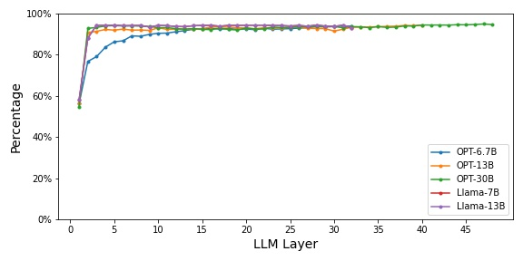
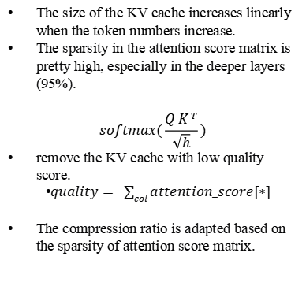
Quality-aware Compression
The size of the KV cache increases linearly when the token numbers increase.
The sparsity in the attention score matrix is pretty high, especially in the deeper layers (95%).
$$softmax(\frac{Q K^{ T}}{\sqrt{h}})$$
remove the KV cache with low quality score.
$quality= \sum_{col}{attention_score[∗]}$
The compression ratio is adapted based on the sparsity of attention score matrix.
Notes:
Here I plan to introduce the Quality-Aware Compression method, a compression method designed to optimize the storage and transfer of KV cache data.
One of the key insights that drove the development of this method is the recognition of the high sparsity in the attention score matrix, particularly in the deeper layers of our model, where it can reach as high as 95%.
Our method leverages the results from the attention score matrix to make informed decisions about which parts of the KV cache need to be retained. This data-driven approach ensures that we preserve only the most relevant information, thereby reducing the overall size of the cache.
Moreover, acknowledging that different layers possess varying degrees of sparsity, our method employs variable compression ratios for different layers. This tailored approach allows us to compress the KV cache more effectively, layer by layer, maximizing the reduction in data size without compromising the integrity of the information.

Slide 19
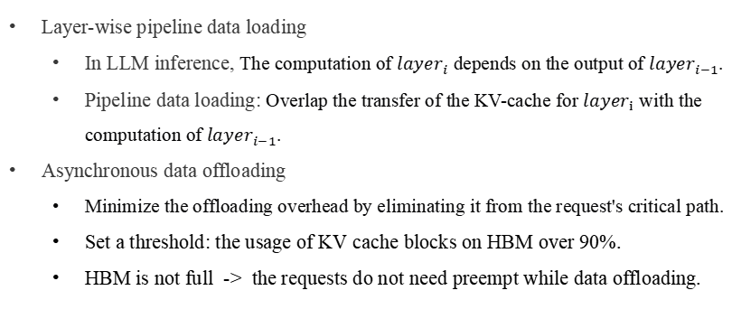
Data Loading and Offloading
Layer-wise pipeline data loading
In LLM inference, The computation of ${layer}_{i}$ depends on the output of ${layer}_{i−1}$.
Pipeline data loading: Overlap the transfer of the KV-cache for ${layer}_{i}$ with the computation of ${layer}_{i−1}$.
Asynchronous data offloading
Minimize the offloading overhead by eliminating it from the request's critical path.
Set a threshold: the usage of KV cache blocks on HBM over 90%.
HBM is not full -> the requests do not need preempt while data offloading.
Notes:
Finally, we use several well-established techniques to handle the data transmission between GPU and external memory.
Firstly, we've adopted a layer-based pipeline data loading method. Recognizing that LLM computation occurs layer by layer, this approach allows us to load data in a pipelined fashion. It ensures that while one layer is being processed, the subsequent layer's data is being preloaded. This overlap of data loading and computation significantly reduces idle times and enhances the throughput of our system.
Secondly, we use asynchronous data offloading. This technique is crucial in managing memory usage efficiently. By setting thresholds that trigger offloading when memory utilization approaches capacity, we prevent GPU out-of-memory errors from impacting the inference process. The offloading operation is performed asynchronously, ensuring that it does not disrupt the critical path of our computations.

Slide 20
04
TestBed and Implementation

Slide 21
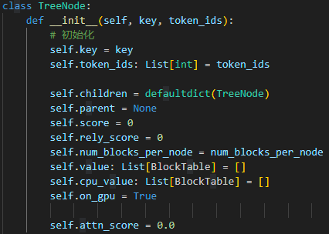
Implementation
Testbed
Based on vLLM framework [1]
Models: OPT-6.7B, OPT-13B, Llama2-7B, Llama2-13B
Datasets: sharedGPT [2]
Implementation
Memory management
Scheduler
Compression
[1]:https://github.com/vllm-project/vllm;
[2]:https://sharegpt.com/
Notes:
Finally, we use several well-established techniques to handle the data transmission between GPU and external memory.
Firstly, we've adopted a layer-based pipeline data loading method. Recognizing that LLM computation occurs layer by layer, this approach allows us to load data in a pipelined fashion. It ensures that while one layer is being processed, the subsequent layer's data is being preloaded. This overlap of data loading and computation significantly reduces idle times and enhances the throughput of our system.
Secondly, we use asynchronous data offloading. This technique is crucial in managing memory usage efficiently. By setting thresholds that trigger offloading when memory utilization approaches capacity, we prevent GPU out-of-memory errors from impacting the inference process. The offloading operation is performed asynchronously, ensuring that it does not disrupt the critical path of our computations.

Slide 22
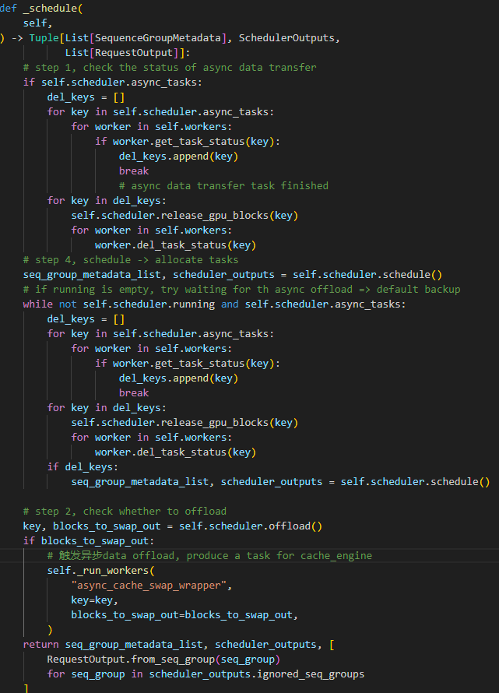
Implementation
Testbed
Based on vLLM framework [1]
Models: OPT-6.7B, OPT-13B, Llama2-7B, Llama2-13B
Datasets: sharedGPT [2]
Implementation
Memory management
Scheduler
Compression
[1]:https://github.com/vllm-project/vllm;
[2]:https://sharegpt.com/
Notes:
Finally, we use several well-established techniques to handle the data transmission between GPU and external memory.
Firstly, we've adopted a layer-based pipeline data loading method. Recognizing that LLM computation occurs layer by layer, this approach allows us to load data in a pipelined fashion. It ensures that while one layer is being processed, the subsequent layer's data is being preloaded. This overlap of data loading and computation significantly reduces idle times and enhances the throughput of our system.
Secondly, we use asynchronous data offloading. This technique is crucial in managing memory usage efficiently. By setting thresholds that trigger offloading when memory utilization approaches capacity, we prevent GPU out-of-memory errors from impacting the inference process. The offloading operation is performed asynchronously, ensuring that it does not disrupt the critical path of our computations.

Slide 23
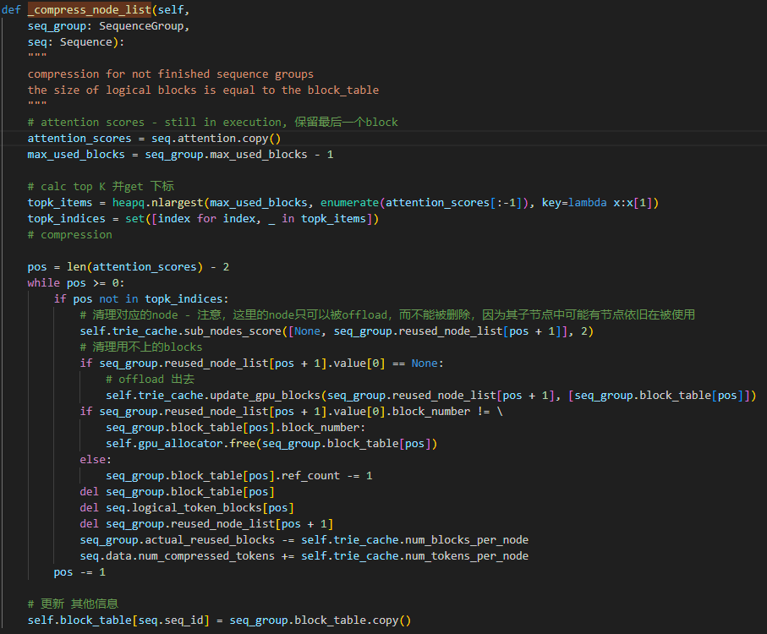
Implementation
Testbed
Based on vLLM framework [1]
Models: OPT-6.7B, OPT-13B, Llama2-7B, Llama2-13B
Datasets: sharedGPT [2]
Implementation
Memory management
Scheduler
Compression
[1]:https://github.com/vllm-project/vllm;
[2]:https://sharegpt.com/
Notes:
Finally, we use several well-established techniques to handle the data transmission between GPU and external memory.
Firstly, we've adopted a layer-based pipeline data loading method. Recognizing that LLM computation occurs layer by layer, this approach allows us to load data in a pipelined fashion. It ensures that while one layer is being processed, the subsequent layer's data is being preloaded. This overlap of data loading and computation significantly reduces idle times and enhances the throughput of our system.
Secondly, we use asynchronous data offloading. This technique is crucial in managing memory usage efficiently. By setting thresholds that trigger offloading when memory utilization approaches capacity, we prevent GPU out-of-memory errors from impacting the inference process. The offloading operation is performed asynchronously, ensuring that it does not disrupt the critical path of our computations.

Slide 24
05
Our Experiment and Conclusions

Slide 25
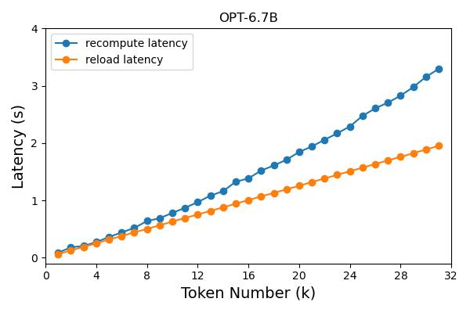
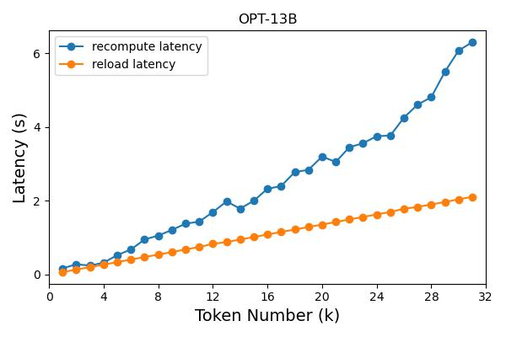
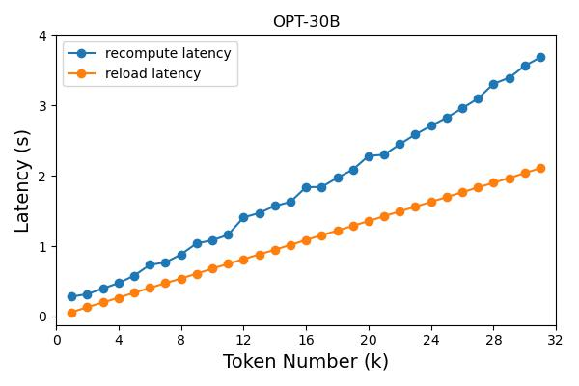
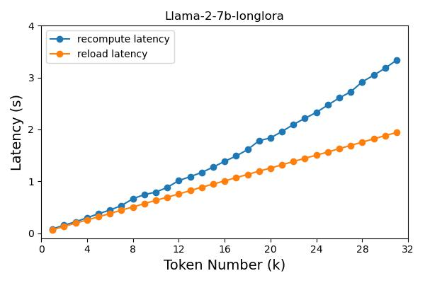
Experiment and Conclusion
Recomputation vs KV cache reused
Leveraging stored KV cache for reuse yields considerable improvements over recomputation.
The KV cache reuse demonstrates the potential to reduce TTFT by 30% in scenarios with long context.
With OPT-13B, this reduction even exceeds 60%.
Notes:
Our preliminary experiment shows that:
Leveraging stored KV cache for reuse yields considerable improvements over re-computation.
we find that the KV cache reuse has the potential to reduce Time to First Token (TTFT) by 30% in scenarios with long context.
Furthermore, when we look at the performance of our system with the OPT-13B model, the benefits become even more pronounced. Here, the reduction in TTFT exceeds 60%.

Slide 26
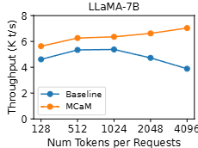
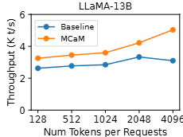
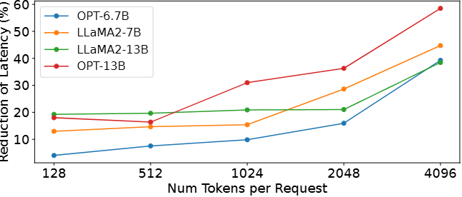
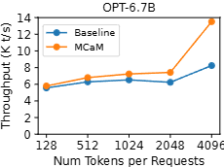
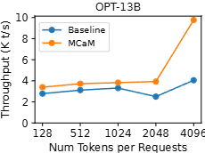
Experiment and Conclusion
Latency Reduction vs prompt length
Notes:
Our preliminary experiment shows that:
Leveraging stored KV cache for reuse yields considerable improvements over re-computation.
we find that the KV cache reuse has the potential to reduce Time to First Token (TTFT) by 30% in scenarios with long context.
Furthermore, when we look at the performance of our system with the OPT-13B model, the benefits become even more pronounced. Here, the reduction in TTFT exceeds 60%.

Slide 27
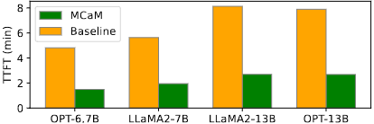
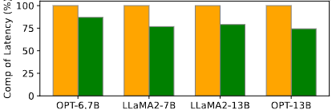
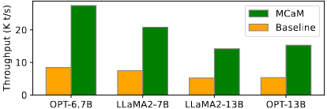
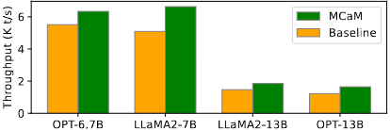
Experiment and Conclusion
Prefill Latency/Throughput Overall Latency/Throughput
Notes:
Our preliminary experiment shows that:
Leveraging stored KV cache for reuse yields considerable improvements over re-computation.
we find that the KV cache reuse has the potential to reduce Time to First Token (TTFT) by 30% in scenarios with long context.
Furthermore, when we look at the performance of our system with the OPT-13B model, the benefits become even more pronounced. Here, the reduction in TTFT exceeds 60%.

Slide 28
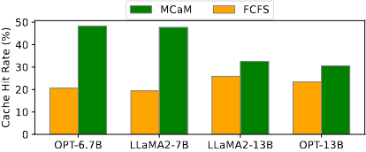
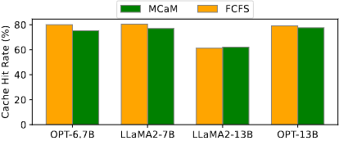
Experiment and Conclusion
Cache Hit Compare (our MCaM vs FCFS)
(a) GPU
(a) Overall
Notes:
Our preliminary experiment shows that:
Leveraging stored KV cache for reuse yields considerable improvements over re-computation.
we find that the KV cache reuse has the potential to reduce Time to First Token (TTFT) by 30% in scenarios with long context.
Furthermore, when we look at the performance of our system with the OPT-13B model, the benefits become even more pronounced. Here, the reduction in TTFT exceeds 60%.

Slide 29
THANKS

